Slide 1

EVEREST PHONES
USER MANUAL

Slide 2
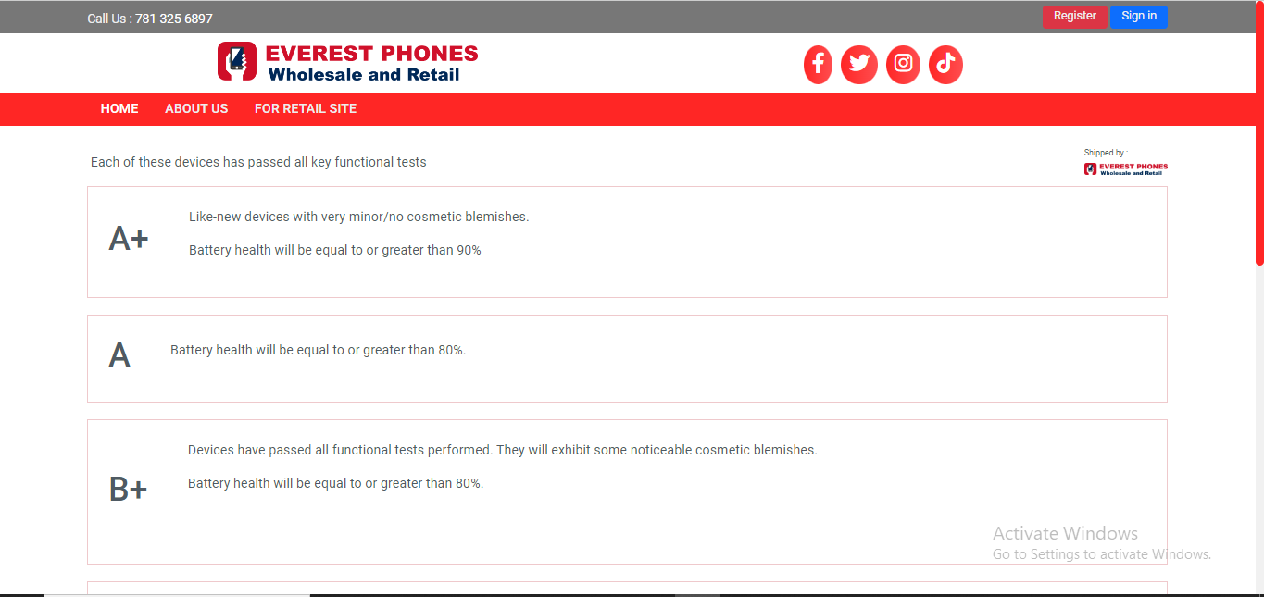
1. Getting Started
To begin shopping, first, create an account by visiting our website at www.everestphones.com and clicking the "Register" button.

Slide 3
1.1 Creating an Account on Everest Phones
To create an account on the Everest Phones Wholesale and Retail site, please follow these steps:
First Name :Enter your first name in the field labeled "First name *".
Last Name :Enter your last name in the field labeled "Last name *".
Business Name :Enter the name of your business in the field labeled "Business name *".
Email :Provide a valid email address in the field labeled "email". This email will be used for account verification and future communication.
Password :Create a strong password in the "Password" field. The password should be at least 8 characters long and include a mix of letters, numbers, and special characters.
Confirm Password :Re-enter the password in the "Confirm password" field to ensure it matches the one you provided above.
Submit the Form :Once all the fields are filled out, click the "Sign Up" button at the bottom of the form to complete your registration.

Slide 4
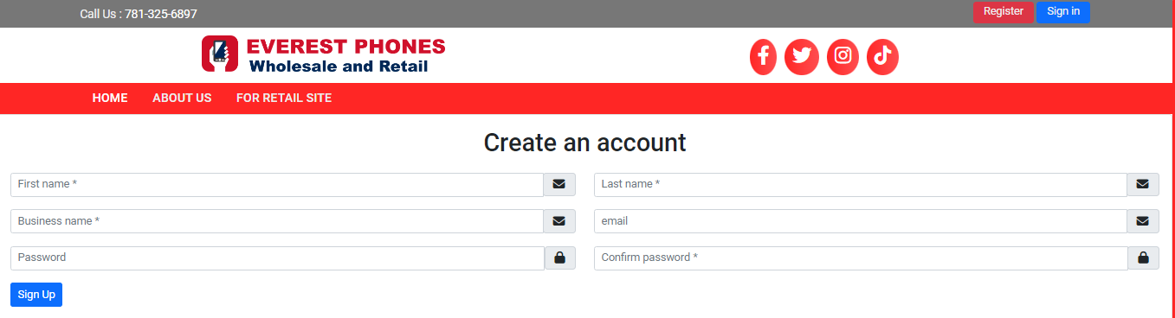
Screenshot of Account Creation

Slide 5
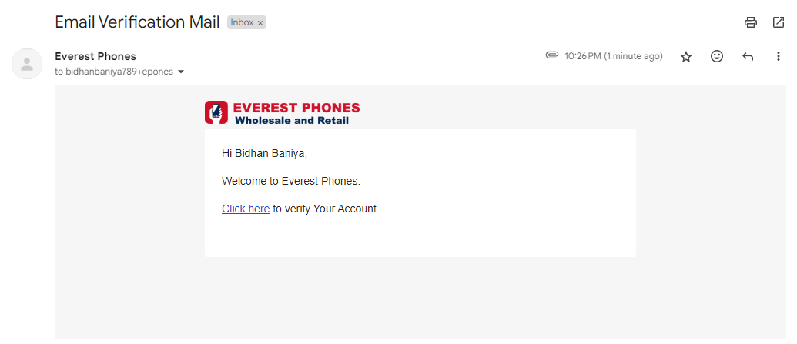
1.2 Email Verification
After submitting the form, check your email for a verification link. Click on this link to verify your email address and wait for account approval.

Slide 6
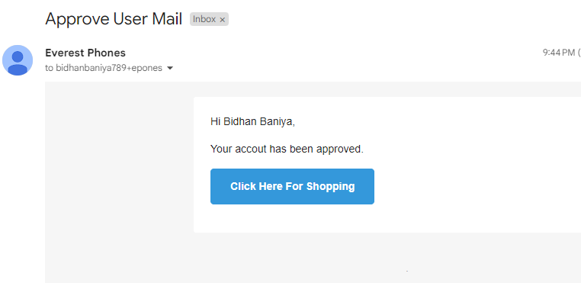
Once your account is approved, you will be notified via the email you used to register.

Slide 7
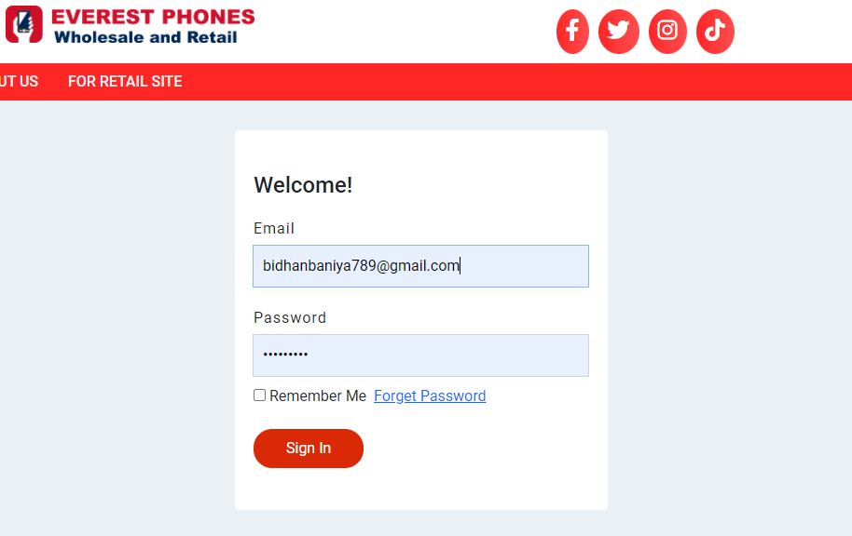
1.3 Sign In
You can sign in by visiting https://everestphones.com/login, entering your email and password credentials, and clicking the 'Sign In' button

Slide 8
1.4 First Time Logging In
Upon your first login, after receiving admin approval, go to https://everestphones.com/login and enter your email and password credentials. Once logged in, you will need to set up your account by providing your business information.
Step 1: Account Setup
When logging into the system for the first time, you will be required to set up your account by providing essential business information. Below are the steps to complete the setup:
1. Business Phone Number
In the "Business phone number" field, enter your business’s primary contact number.
Enter the phone number without the country code.
2. WhatsApp Number (Optional)
If you use WhatsApp for business communication, enter your WhatsApp number in the "WhatsApp number" field.

Slide 9
Step 2: Business Address Setup
Next, you’ll need to fill in your business address details to complete the setup process:
1. Country
Select the country where your business is located from the dropdown list Default is United State.
2. State/Province
Choose your business’s state or province. This field will adjust based on the selected country.
3. City
Enter the city in which your business operates.
4. Street Address
Provide the full street address of your business. This is required for accurate identification and correspondence.
5. Zip/Postal Code
Enter the relevant zip or postal code for your business location.
6. Upload Reseller Certificate
You will need to upload your reseller certificate. To do this, click the Choose File button, select the appropriate file from your device, and upload it.

Slide 10
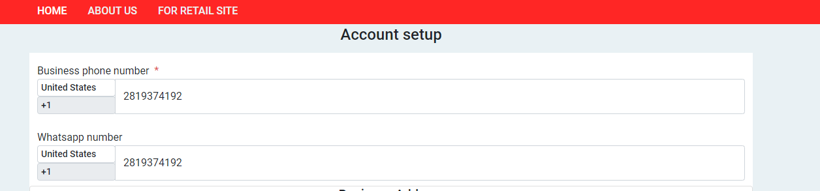
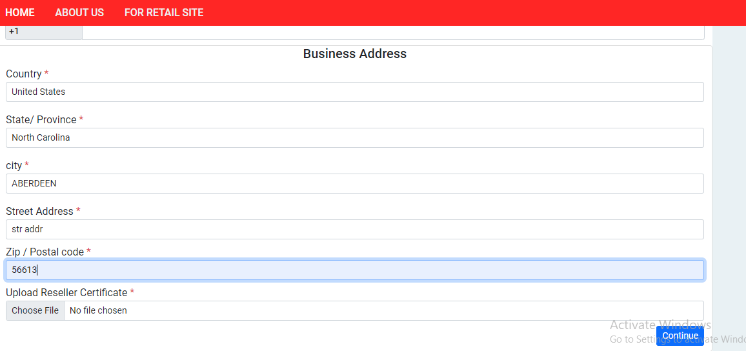
1.5 Screenshot of Account Setup with demo information

Slide 11
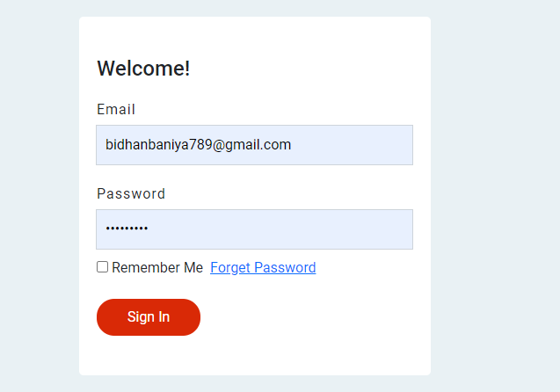
2. Account Access and Core Functions
Unlock a World of Amazing Phones at Your Fingertips
Step 1: Visit our secure login page at https://everestphones.com/login
Step 2: Enter your registered email address and password
Step 3: Click 'Sign In' to access your account and start exploring!

Slide 12
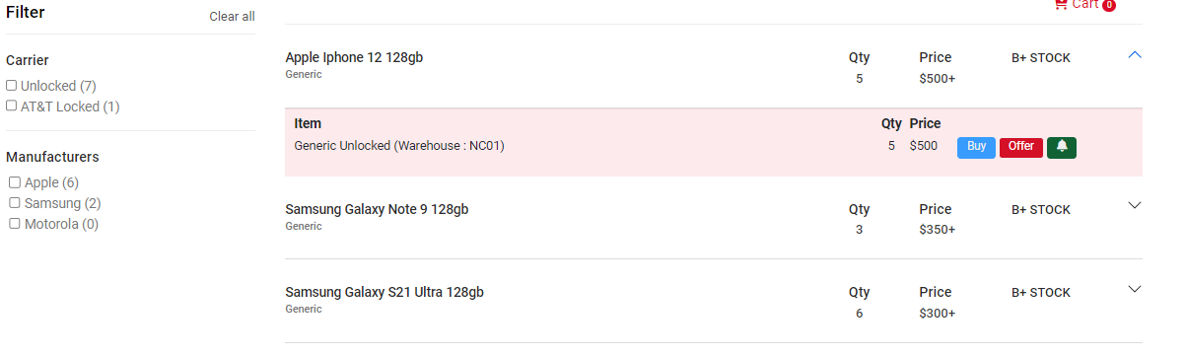
2.1 Stock List
After a successful login, you'll embark on your phone-hunting journey:
Instant Access: You'll be whisked away to our virtual showroom at https://everestphones.com/stock-list
Your Personal Catalog: Behold a curated list of our latest and greatest phones, each with:
• Real-time availability • Competitive pricing • Quality grade scale
Dive Deeper: Curious about a specific model? Simply click on any product to uncover:
• Detailed information • Current warehouse location

Slide 13
2.2 Shipping phones from Everest Phones
When you're ready to make a move on your desired phone, the process couldn't be simpler:
Locate the "Buy Now" button on any product page.
Click it to open a handy modal window.
Use the controls to adjust the quantity you'd like to purchase.
Review the detailed product info one more time.
Click "Add to Cart" to safely stow your selection.
Your items are now nestled in your personal shopping cart, just waiting for you to complete the checkout process.
From here, you can continue browsing our full stock list, adjust quantities as needed, or proceed to finalize your order. It's all about giving you the control and flexibility to shop with confidence.

Slide 14
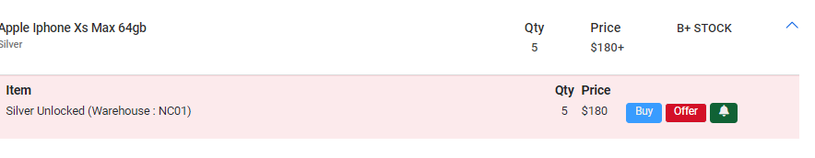
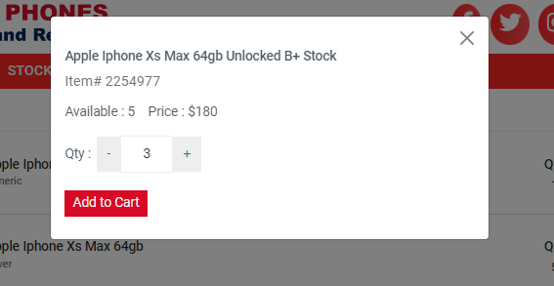
2.3 Screenshot of adding item in cart

Slide 15
2.2 Finalizing Your Order: From Cart to Checkout
Ready to seal the deal on your new phone? Here's how to breeze through the checkout process:
Locate Your Cart: Find the cart icon in the top-right corner of any page. It's your treasure chest of selected items!
Review Your Selections: Click the cart icon to be whisked away to https://everestphones.com/cart
Fine-tune Your Order: • Remove items: Spot a change of heart? Click the 'X' icon next to any item to remove it. • Adjust quantities: Use the quantity controls to get exactly what you need.
Ready, Set, Purchase: When you're satisfied with your selections, hit the "Checkout" button to proceed.
Pro Tip: Double-check your cart before checking out. It's the perfect moment to ensure you're getting everything you want (and nothing you don't)!

